Slide 1
Portfolio
Nikhil S

Slide 2
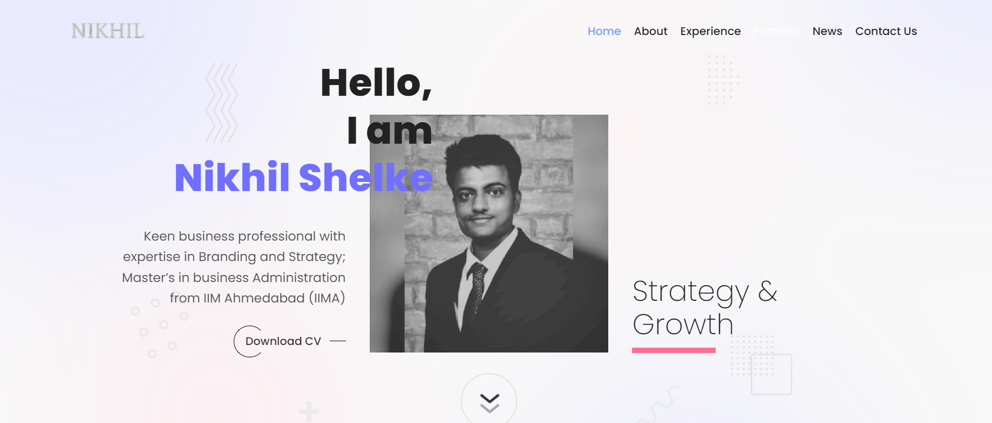
Change Name to Nikhil S
Reduce image size by 20%
Change the upper left corner name NIKHIL to Nikhil S
Please ensure the nav bar appears throughout the portfolio when curser is moved to top of page

Slide 3
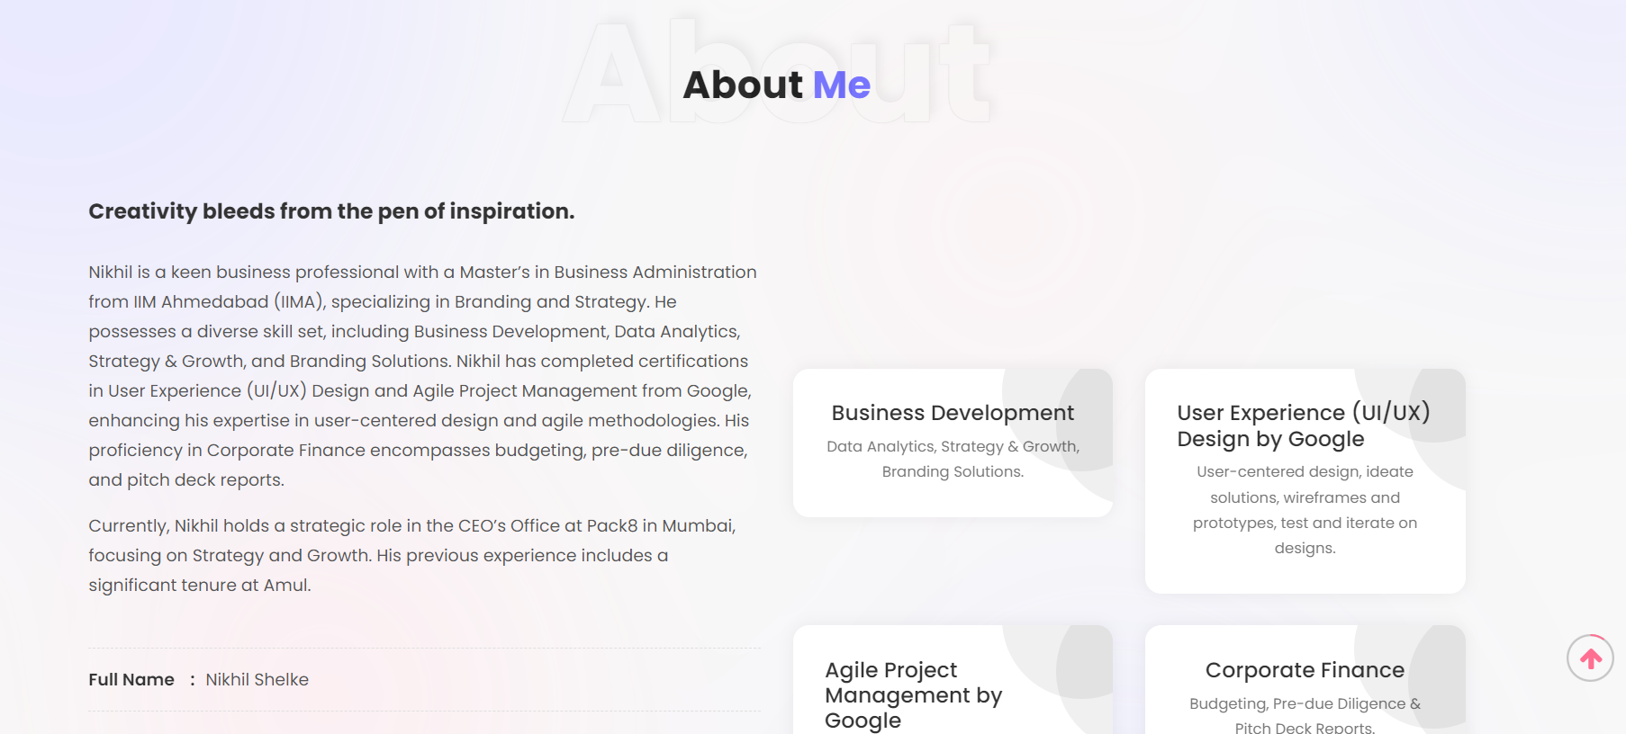
Change Title Creativity Bleeds from Pen.. to Keen Business Professional with Diverse Set of Skills
Change the certification boxes in following order
1. Business Development
2. Corporate Finance
3. UX/UI Design
4. Agile

Slide 4
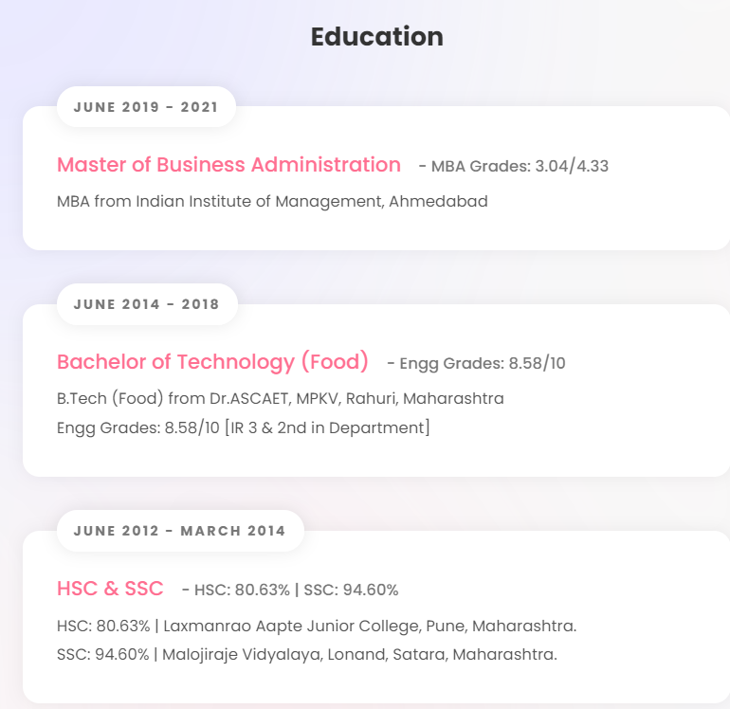
In sub header
Change it to MBA (PGP-FABM) from Indian Institute of Management from IIMA
Header change to
Bachelor of Technology (Food) to Bachelor of Technology (B.Tech)
Change subheader details (Food) to (Food & Agril.)
Change headers
SSC to 10th SSC and HSC to 12th HSC (in subheaders too)
Keep SSC details first and then HSC

Slide 5
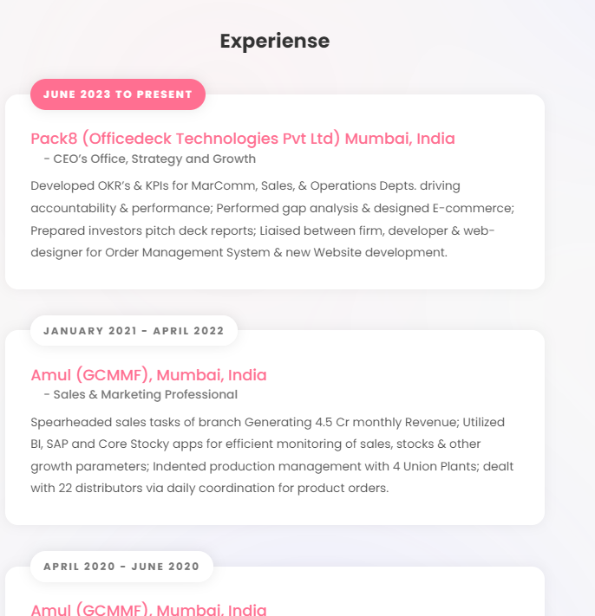
Header change to
Experience to Work Experience

Slide 6
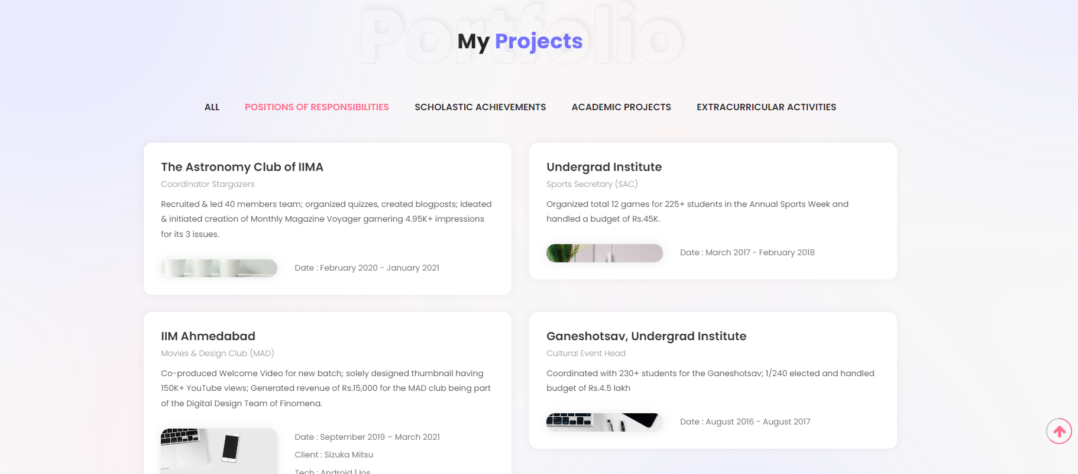
Change Title My Projects to Achievements
Change Subtitle order as follow
PoR’s ------------Scholastic Achievements-----------Academic Projects------------Extracurriculars---------All

Slide 7
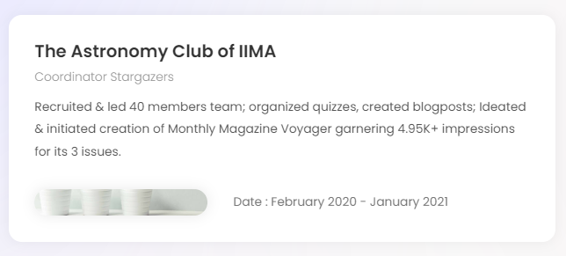
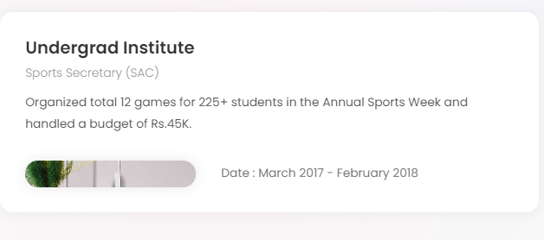
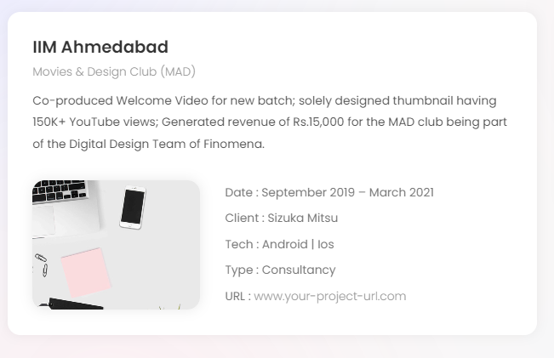
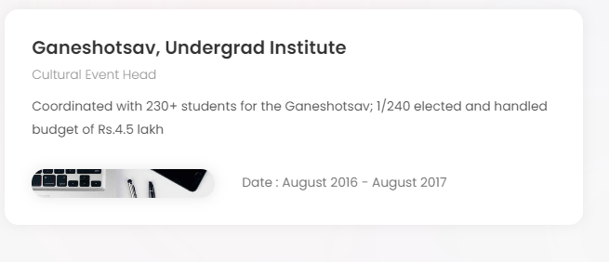
Header change to: Coordinator Stargazers, The Astronomy Club of IIMA
Subheader to: Club Head at IIMA
Header change to: Sports Secretary (SAC)
Sub-header change to: Undergrad Institute, B.Tech
Header change to: Movies and Design Club, IIMA
Sub-header change to: IIM Ahmedabad
Header change to: Cultural Event Head
Sub-header change to: Ganeshotsav, Undergrad Institute

Slide 8
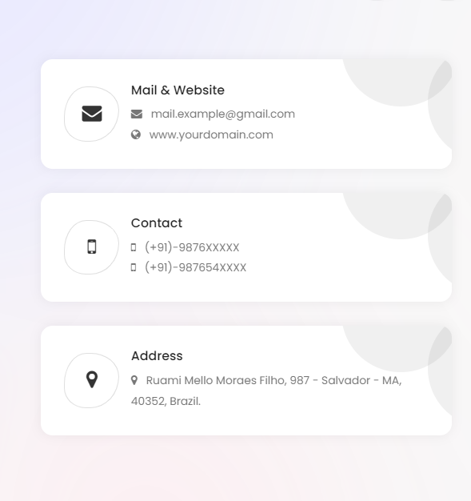
Mail:
a19nikhils@gmail.com
https://niikhils.github.io/nikhils.github.io/
Contact
9561280118
9423964039
Address
Pune, India.

